Slide 1

Lending Case Study Analysis
LOKESH Kshitij

Slide 2
Objective
The objective of this case study is to mitigate credit loss by effectively identifying high-risk loan applicants. By employing Exploratory Data Analysis (EDA), the study seeks to discern key factors influencing loan default.
By understanding the underlying drivers of default, the company can streamline its lending practices, minimize exposure to risky borrowers, and ultimately reduce the volume of defaulted loans. This proactive approach not only safeguards the company's financial stability but also enhances its ability to make informed lending decisions.

Slide 3
Problem Statement
High Default Rates:
Our lending portfolio has been experiencing a high rate of loan defaults.
Objective:
Identify key factors that contribute to loan defaults and develop a predictive model to mitigate these risks.

Slide 4
Analysis Approach
Data Cleaning - Handling missing values, outlier detection.
Univariate Analysis - Understand basic characteristics and distribution of each variable
Bivariate Analysis - Identify correlations and dependencies to find potential risk factors
Correlation Matrix - Identify variables that have a high correlation with loan default .
Conclusion - Summary of key insights.

Slide 5
Data Cleaning
Missing Value Treatment
Removing rows or columns with excessive missing values if they exceed a certain threshold.
Impute missing numerical values with mean, median, or mode.
Outlier Detection and Treatment:
Transforming variables to reduce the impact of extreme values
Dropping outliers if they are errors.
Duplicate Records Removal:
Removed duplicate records to avoid biased analysis and redundant data processing

Slide 6
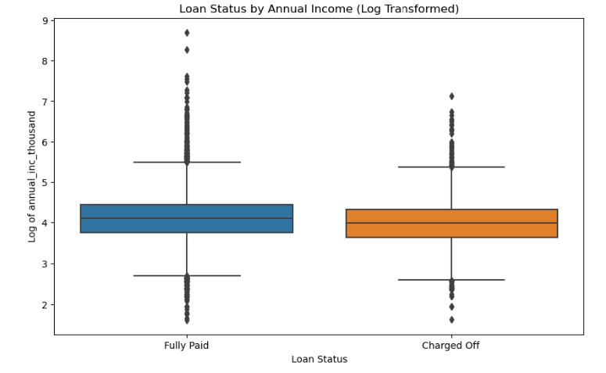
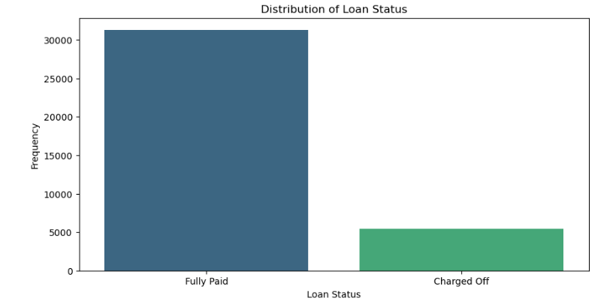
Univariant Analysis
Income :- By looking Graph, we can say that people with Lower income rate tend to default the Loans

Slide 7
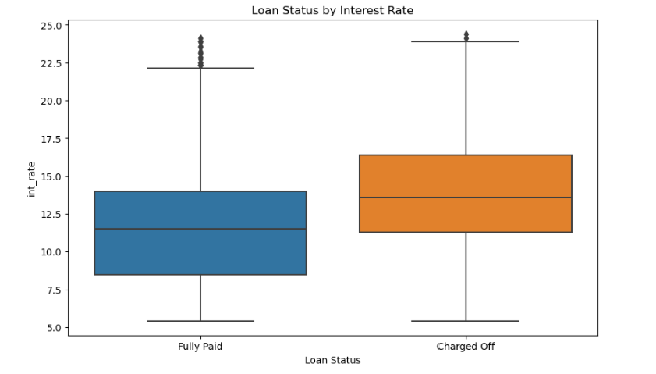
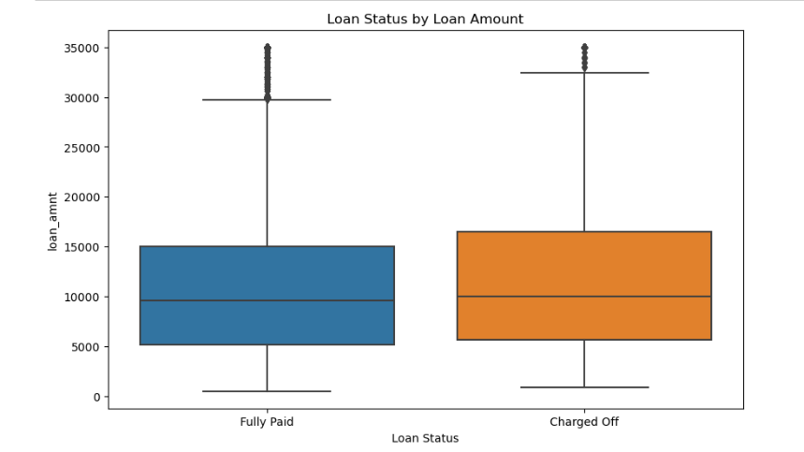
Loans
People with higher interest rate of loans tend to default the loans.
Larger loan amounts show a higher tendency towards being default.

Slide 8
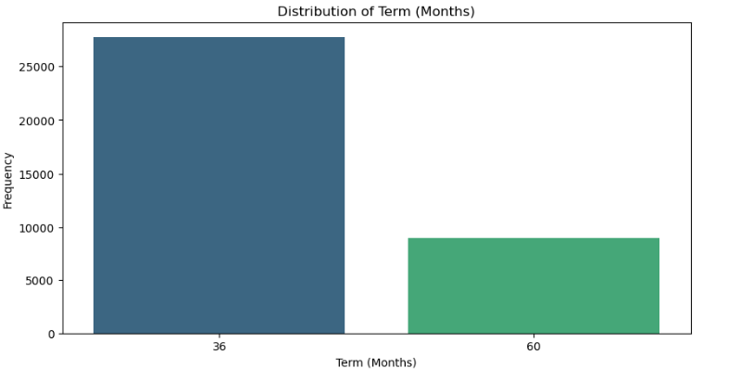
Tenure
The majority of loans have a term of 36 months and majority are fully paid.

Slide 9
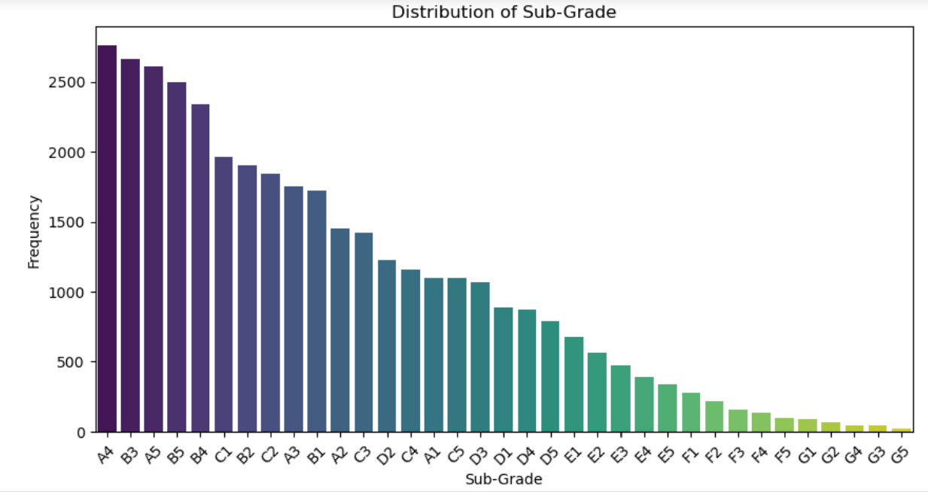
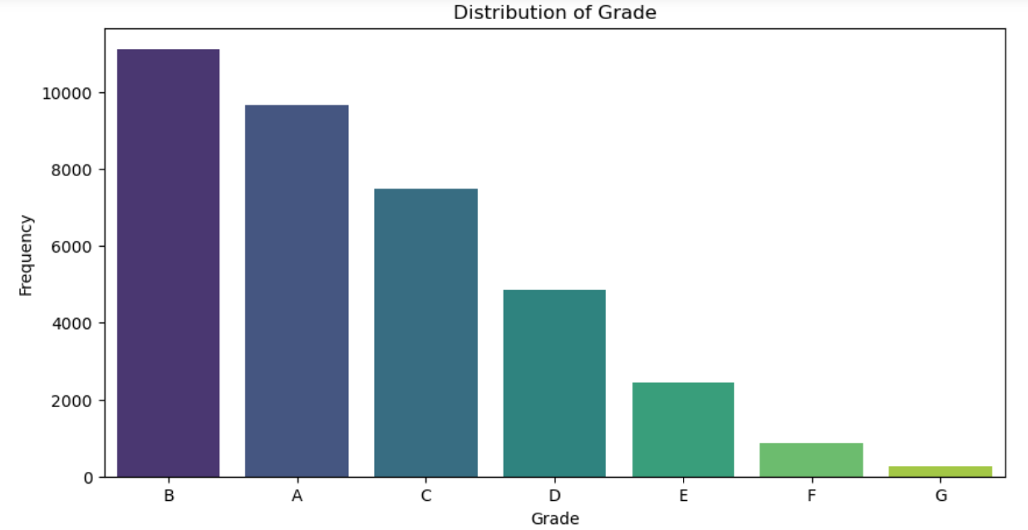
Grades
Grade :- Most loans are graded B , A and C, indicating a moderate risk profile of the loan applicants.
Sub-Grade :- Sub-grades provide a finer distribution within grades, with sub-grades A4, B3, and A5 being the most common.

Slide 10
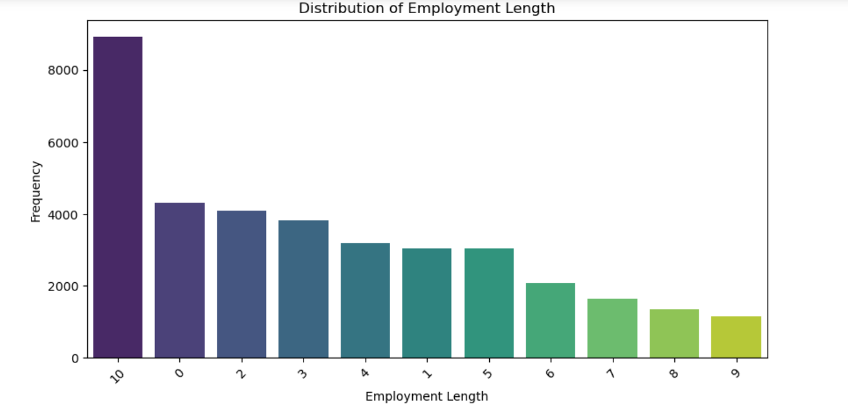
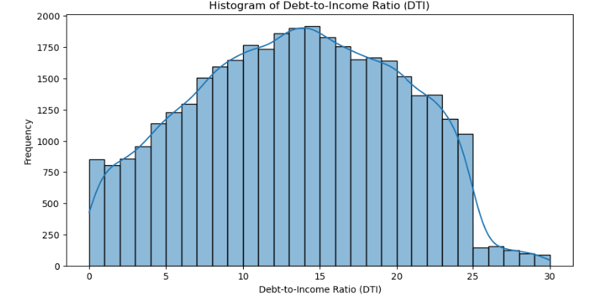
Observation
Employment Length :- Most borrowers of loan have 10+ years of employment.
Debt-to-Income Ratio (DTI) : - The DTI ratio is mostly below 30%, indicating that most borrowers have a manageable level of debt relative to their income.

Slide 11
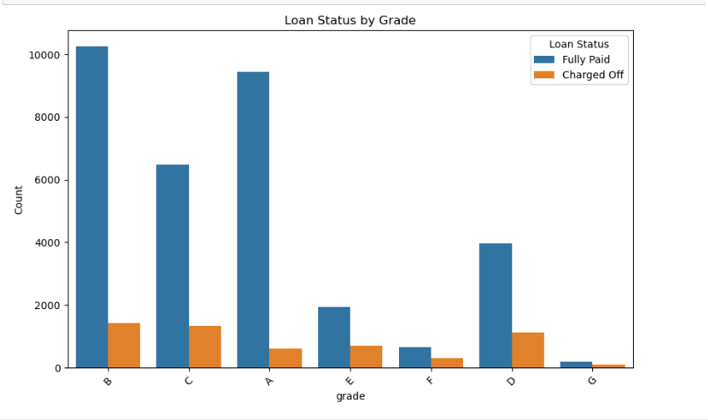
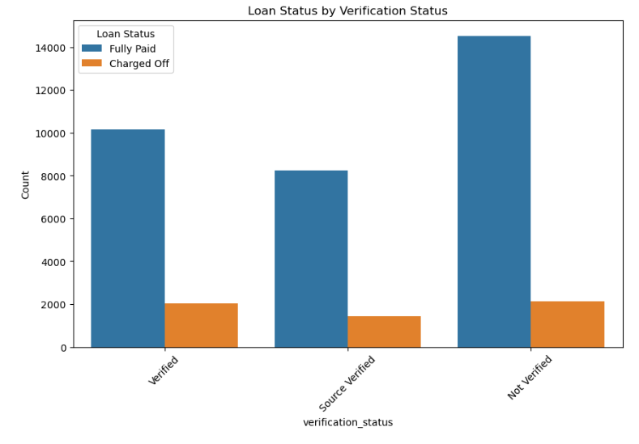
Bivariant
Grade:- Lower loan grades (D, E, F, G) have higher default rates compared to higher grades (A, B, C).
Status – Loans with unverified income have a higher default rate.

Slide 12
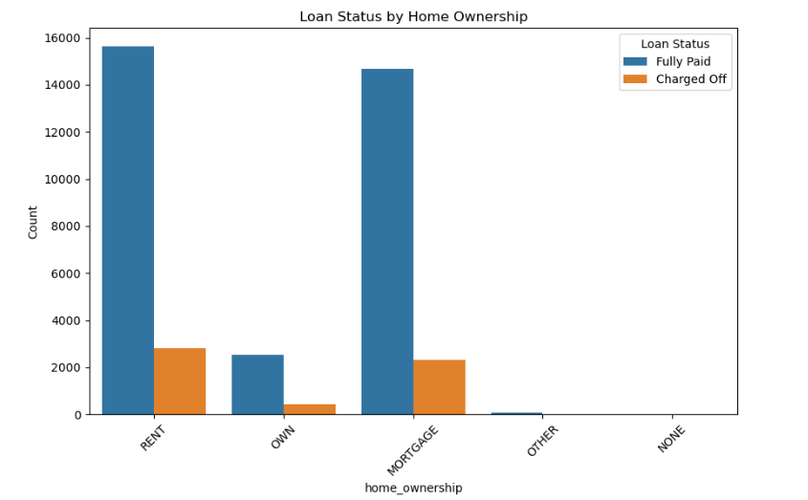
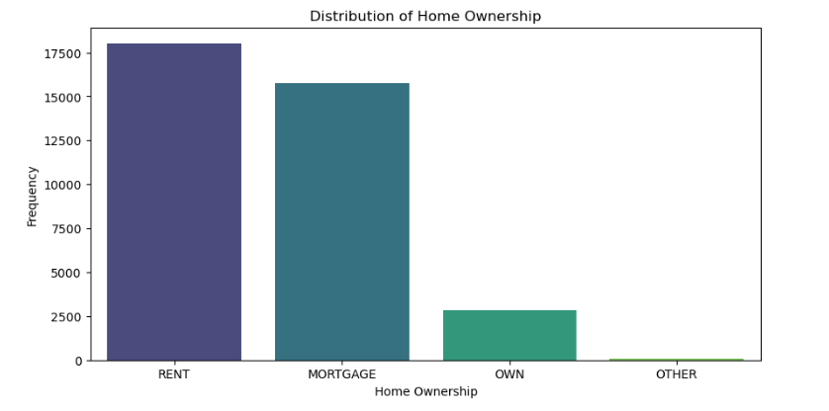
Home Ownership :- Most borrowers are either renting or have mortgages cause for defaulting the Loan

Slide 13
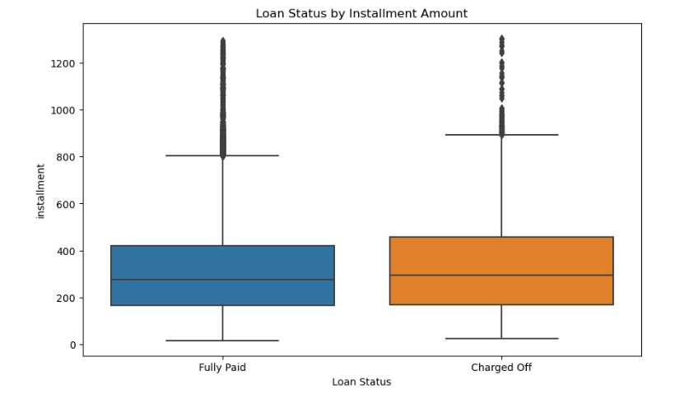
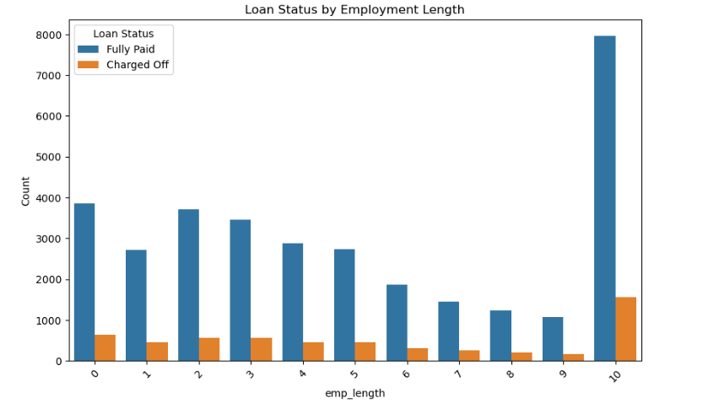
Employee length :- Borrowers with high employment lengths have a higher rate of defaults
Installment :- Higher monthly installments are associated with a higher default rate

Slide 14
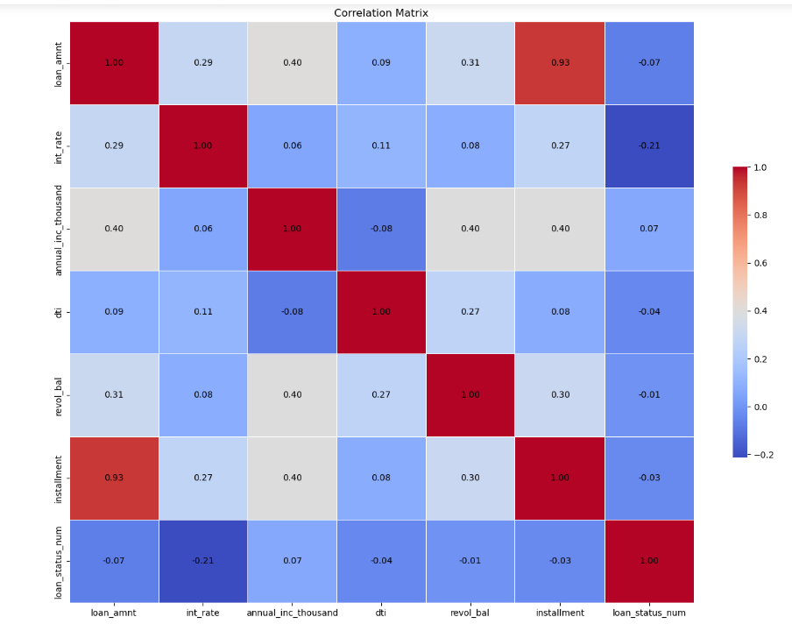
Correlation Matrix
The interest rate shows the most significant correlation implying that loans with higher interest rates are slightly more likely to default.

Slide 15
Conclusion :-
Higher monthly installments are associated with a higher default rate.
Higher DTI ratios are associated with a higher default.
The lower annual incomes tend to default more frequently.
Higher interest rates correlate with a higher proportion of charged-off loans
Larger loan amounts show a higher tendency towards being charged-off.
Borrowers with large employment lengths have a higher rate of defaults
Lower loan grades have higher default rates compared to higher grades.
Loans taken for debt consolidation have higher default rate.

Slide 16
Loans with unverified income have a higher default rate than those with verified loans.
Renters and people who have mortgages have a higher default rate compared to others.

Slide 17
THANK YOU

